Slide 1
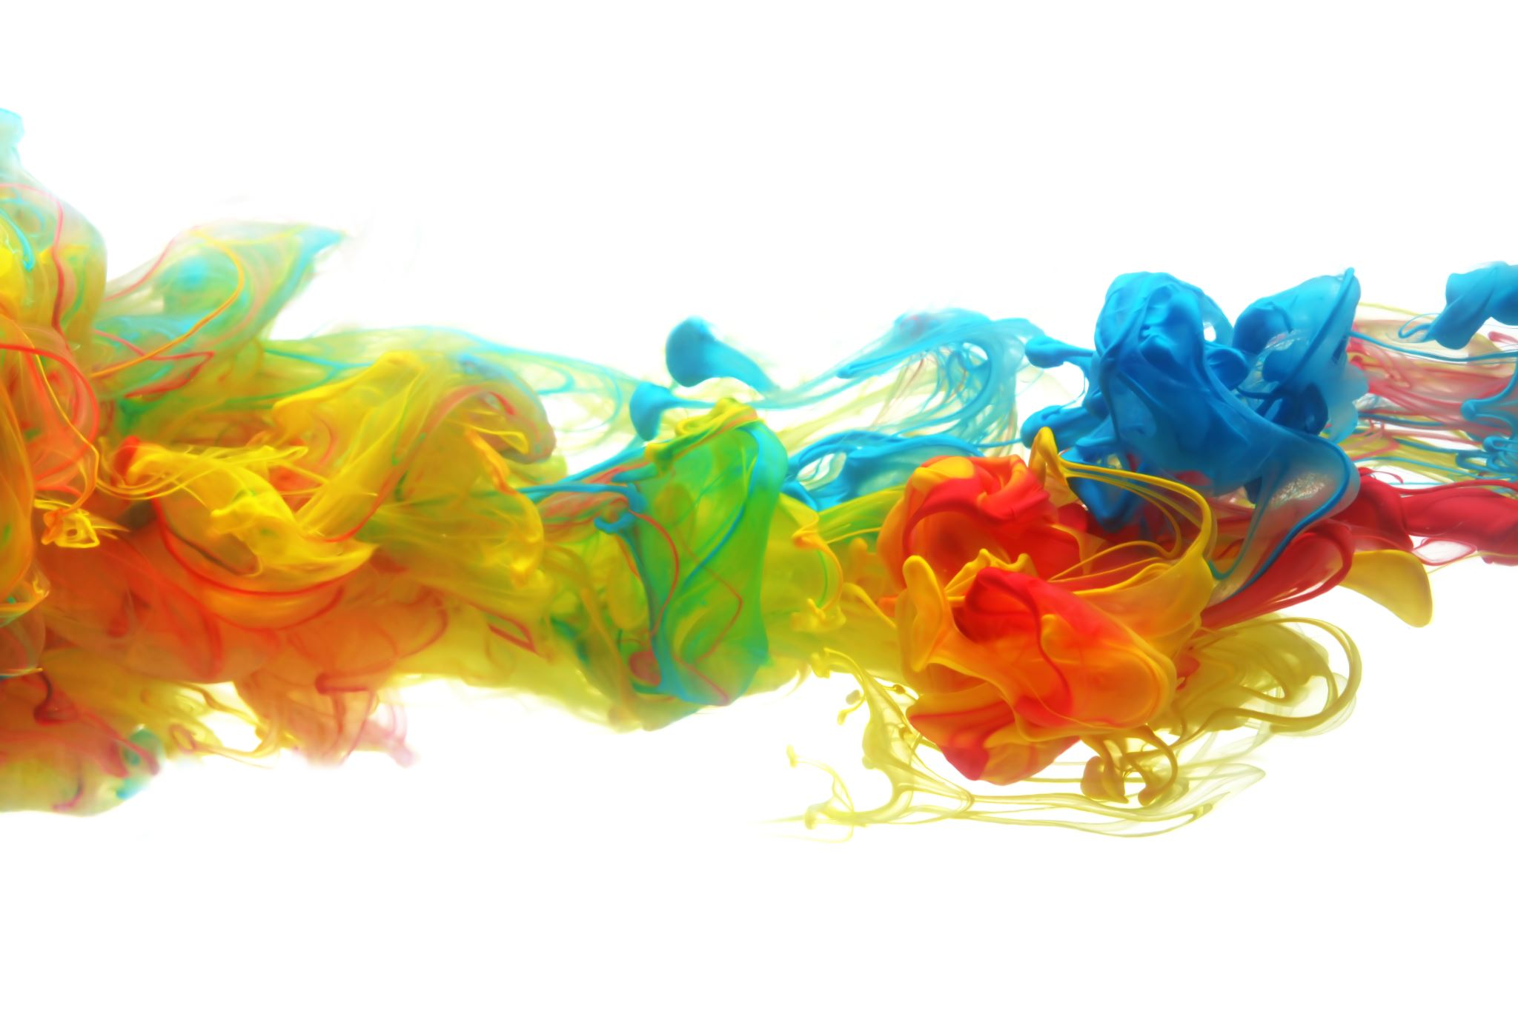
Machine Learning for Hypersonic Laminar-to-Turbulent Transition
Fouad Ayoub
Advisor: Dr. Christoph Brehm

Slide 2
Importance of Laminar-to-Turbulent Transition
The laminar-to-turbulent transition in hypersonic flows is crucial to understand because it significantly impacts the aerodynamic performance, heat transfer, and structural integrity of high-speed vehicles.
In hypersonic regimes, the transition to turbulence can lead to increased drag, higher thermal loads on the vehicle surface, and potential instability.

Slide 3
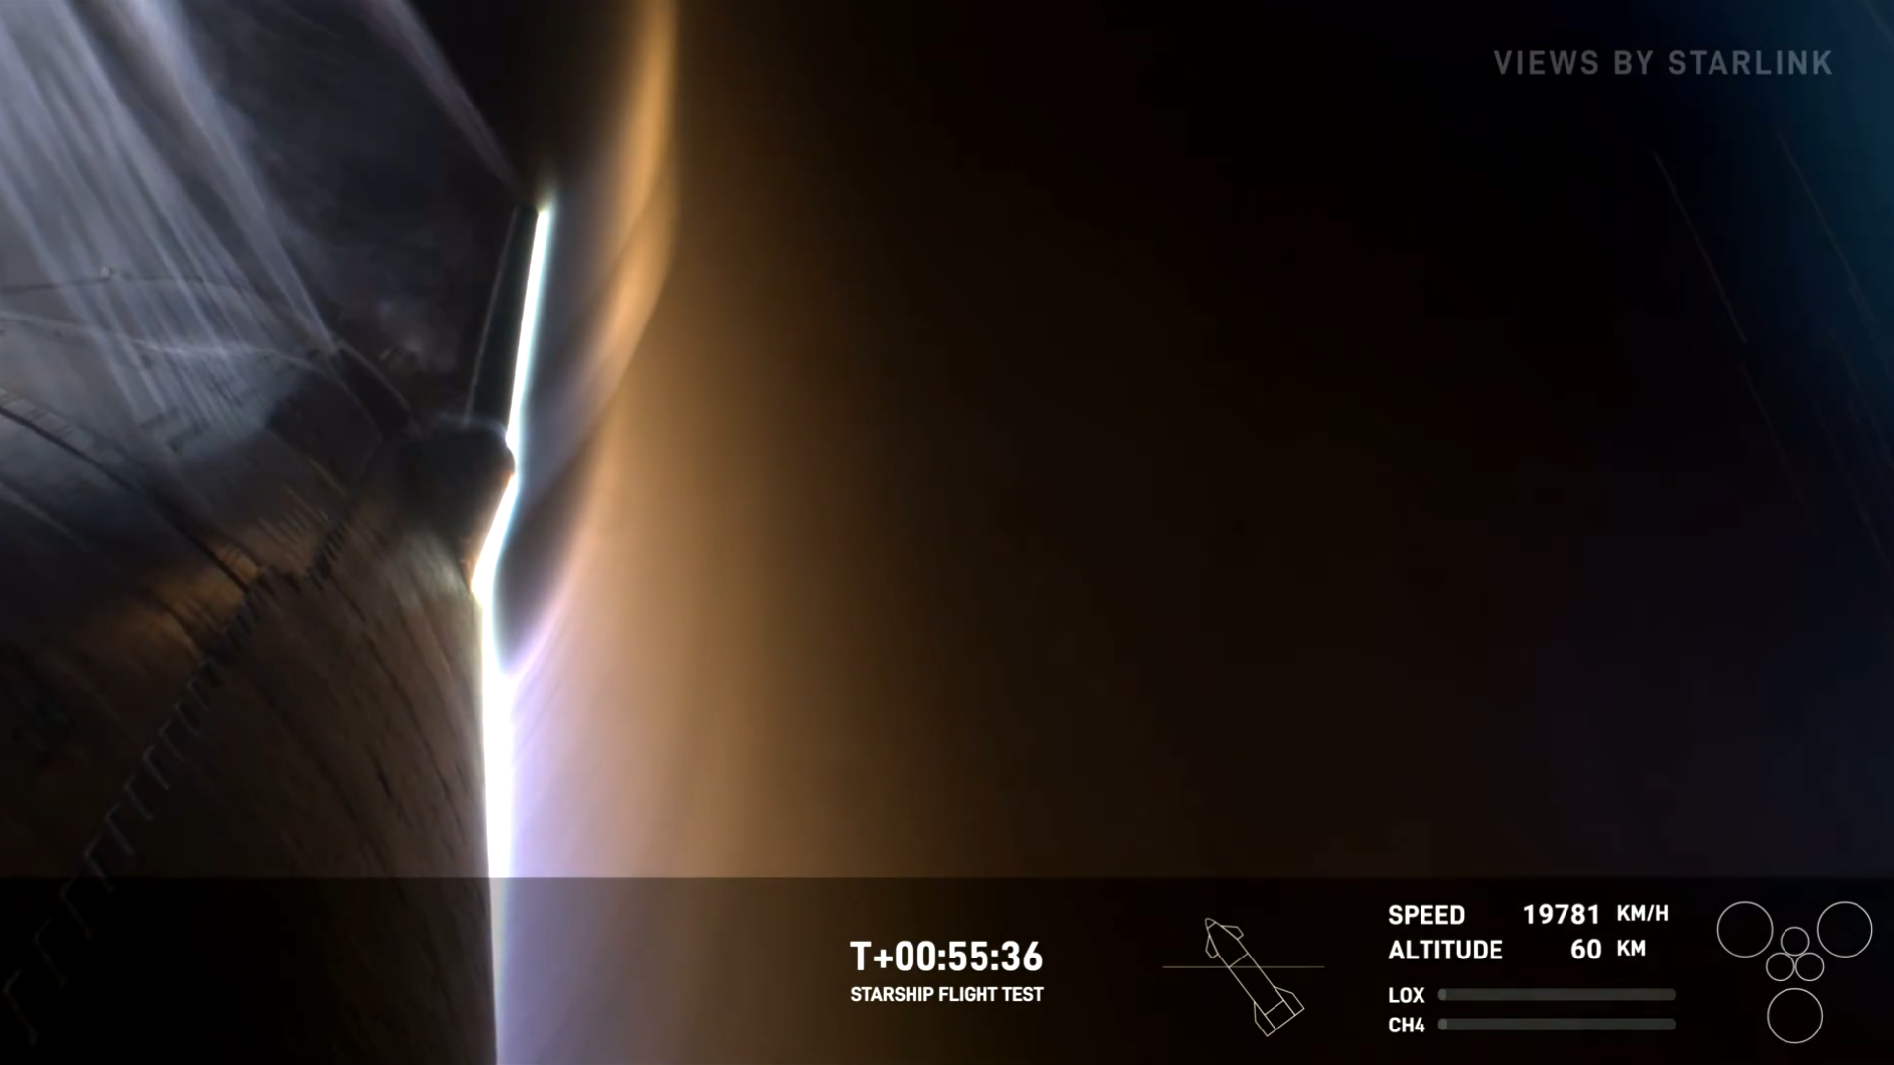

Slide 5
At 60km, Starship is travelling at Mach 17.2!
Notes:
Assuming ATM temperature at 60km is approximately -20 C
In this image from the SpaceX IFT-4 flight test, we see the Starship traveling at an incredible speed of Mach 17.2 at an altitude of 60km. We can see that at these hypersonic speeds, shock waves and intense heating occurs due to aerodynamic friction. These phenomena are directly influenced by the flow transition, because it determines the severity of the conditions at different points in the flow. Understanding where the flow transitions can inform design choices like thermal management—accurate prediction helps in designing thermal protection systems to manage the extreme heat loads, ensuring the structural integrity and safety of the spacecraft. It also can lead to design optimizations that minimize drag to reduce heating and improve fuel efficiency. Understanding the extent of a turbulent flow by determining transition also can inform whether there will be aerodynamic instabilities that would be important for designing control surfaces and algorithms for the vehicle.

Slide 6
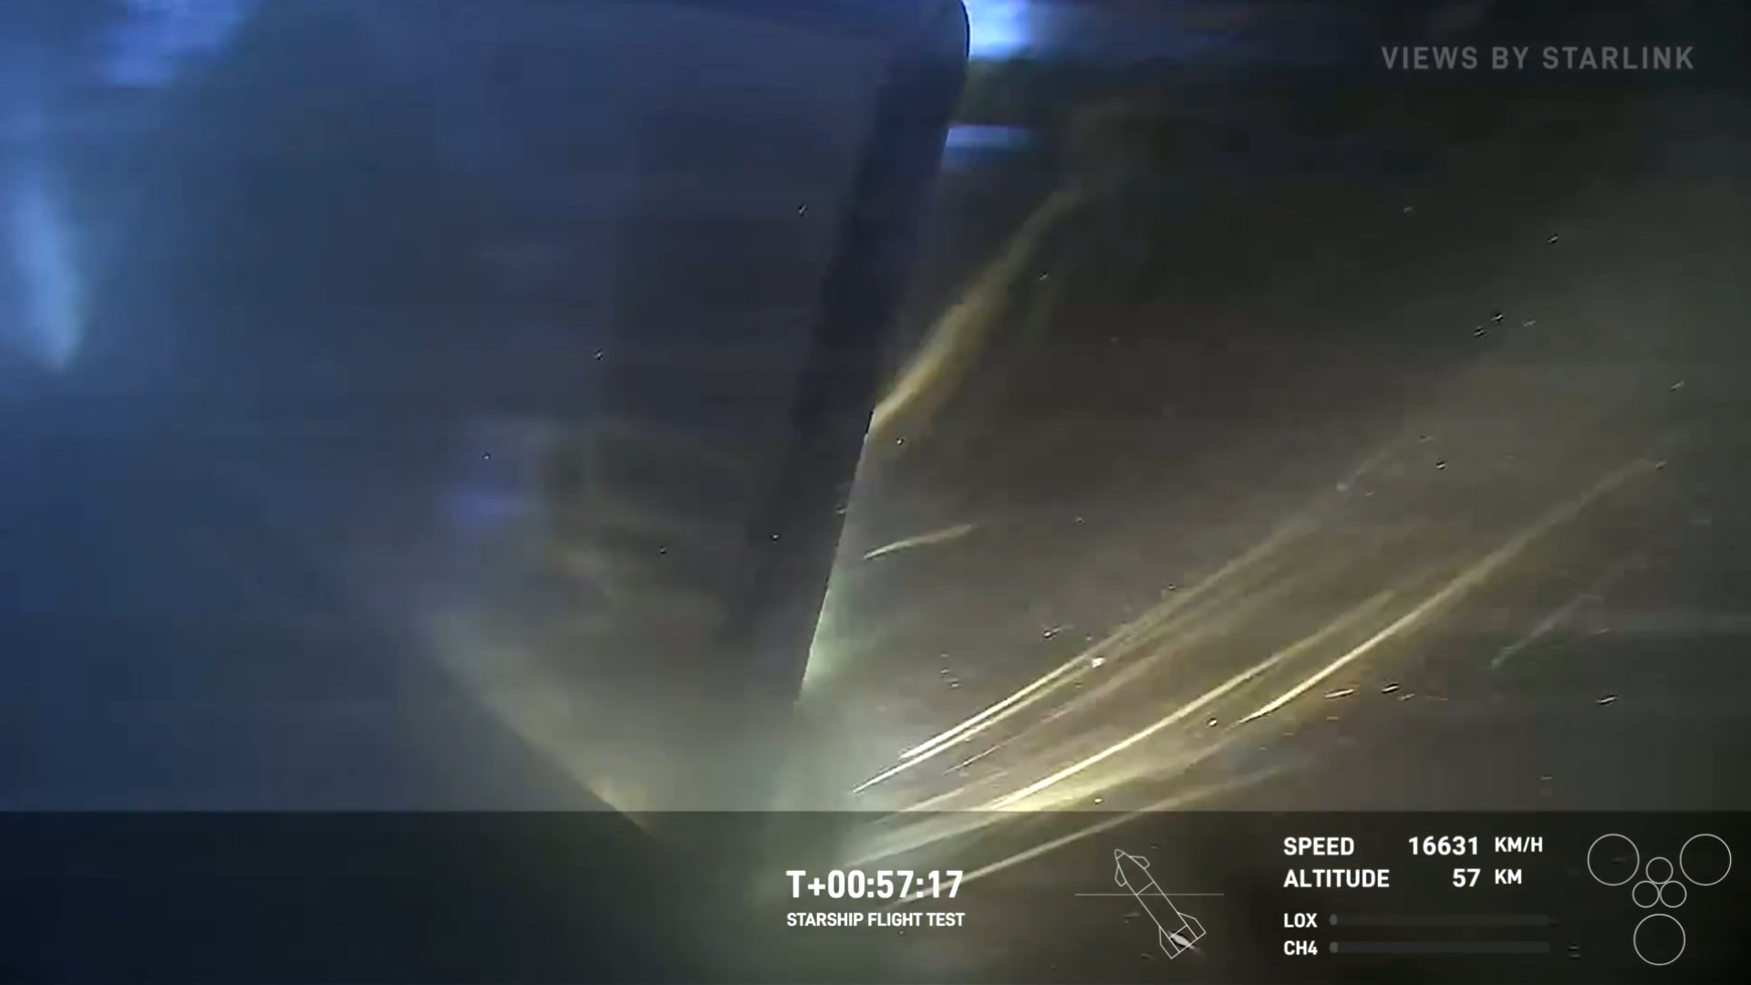
Notes:
As the Starship continues its descent to re-enter the Earth’s atmosphere, it experiences even more heating and stress, especially on the fins that are the primary control surfaces of the vehicle. We see that the heating is so intense, some portions of the fin get burned off, as the plasma and intense pressure pushes its way between the hinge of the fin.

Slide 7
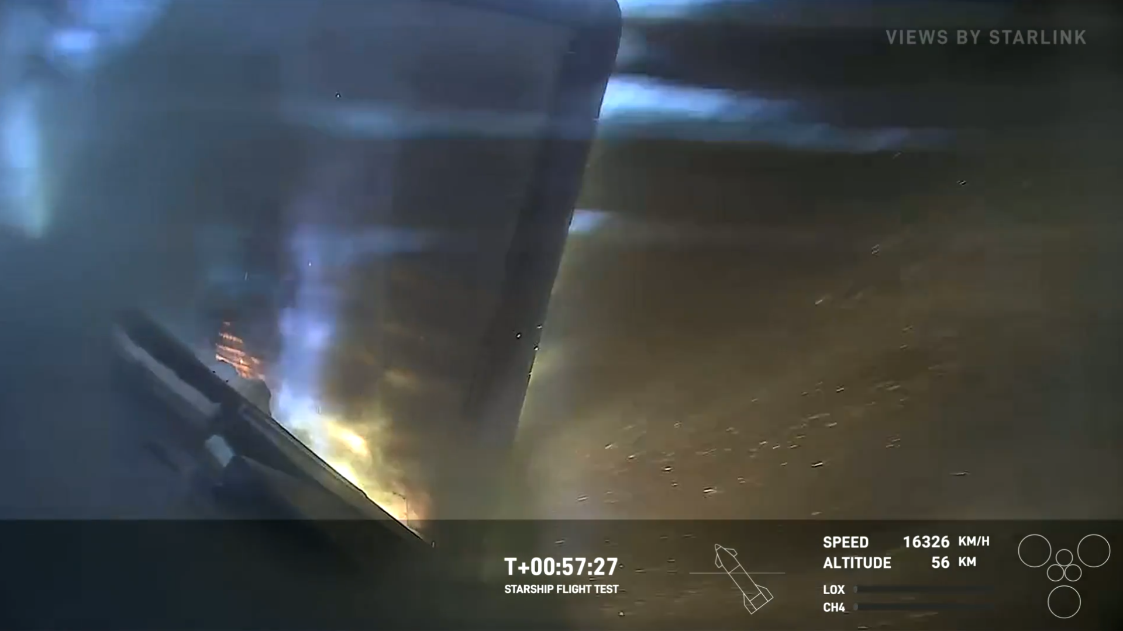

Slide 8
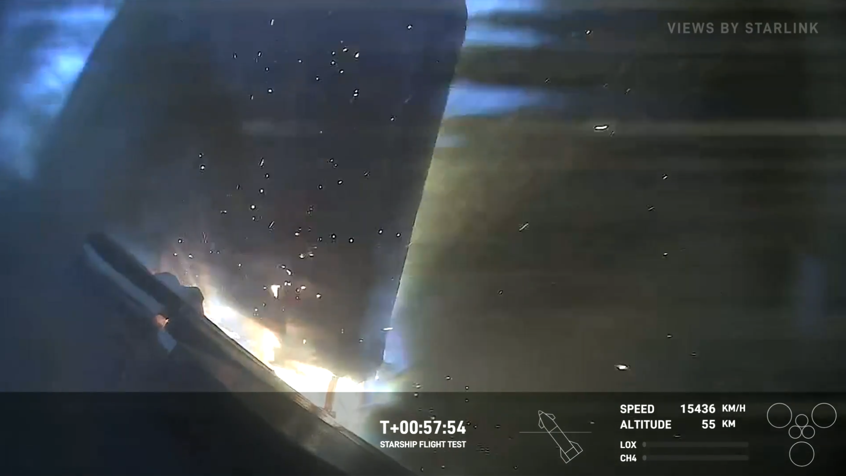

Slide 9
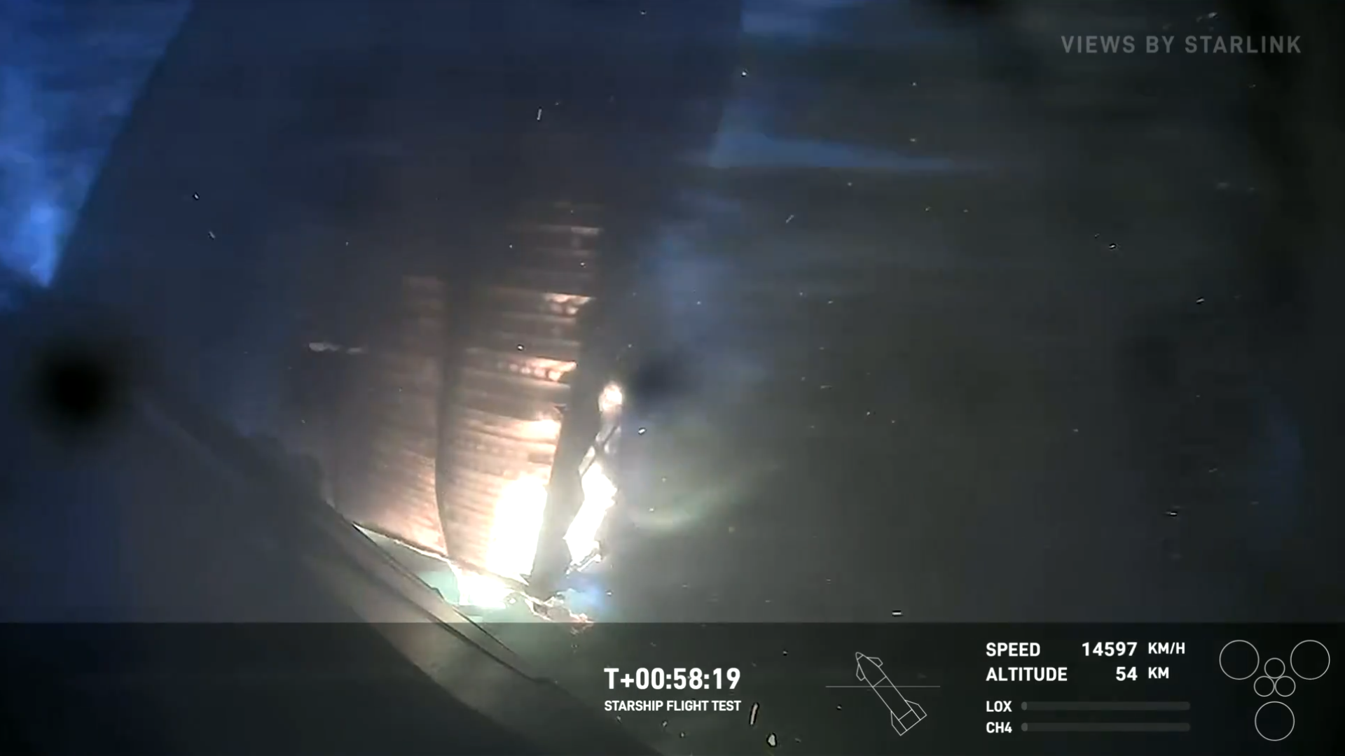

Slide 10
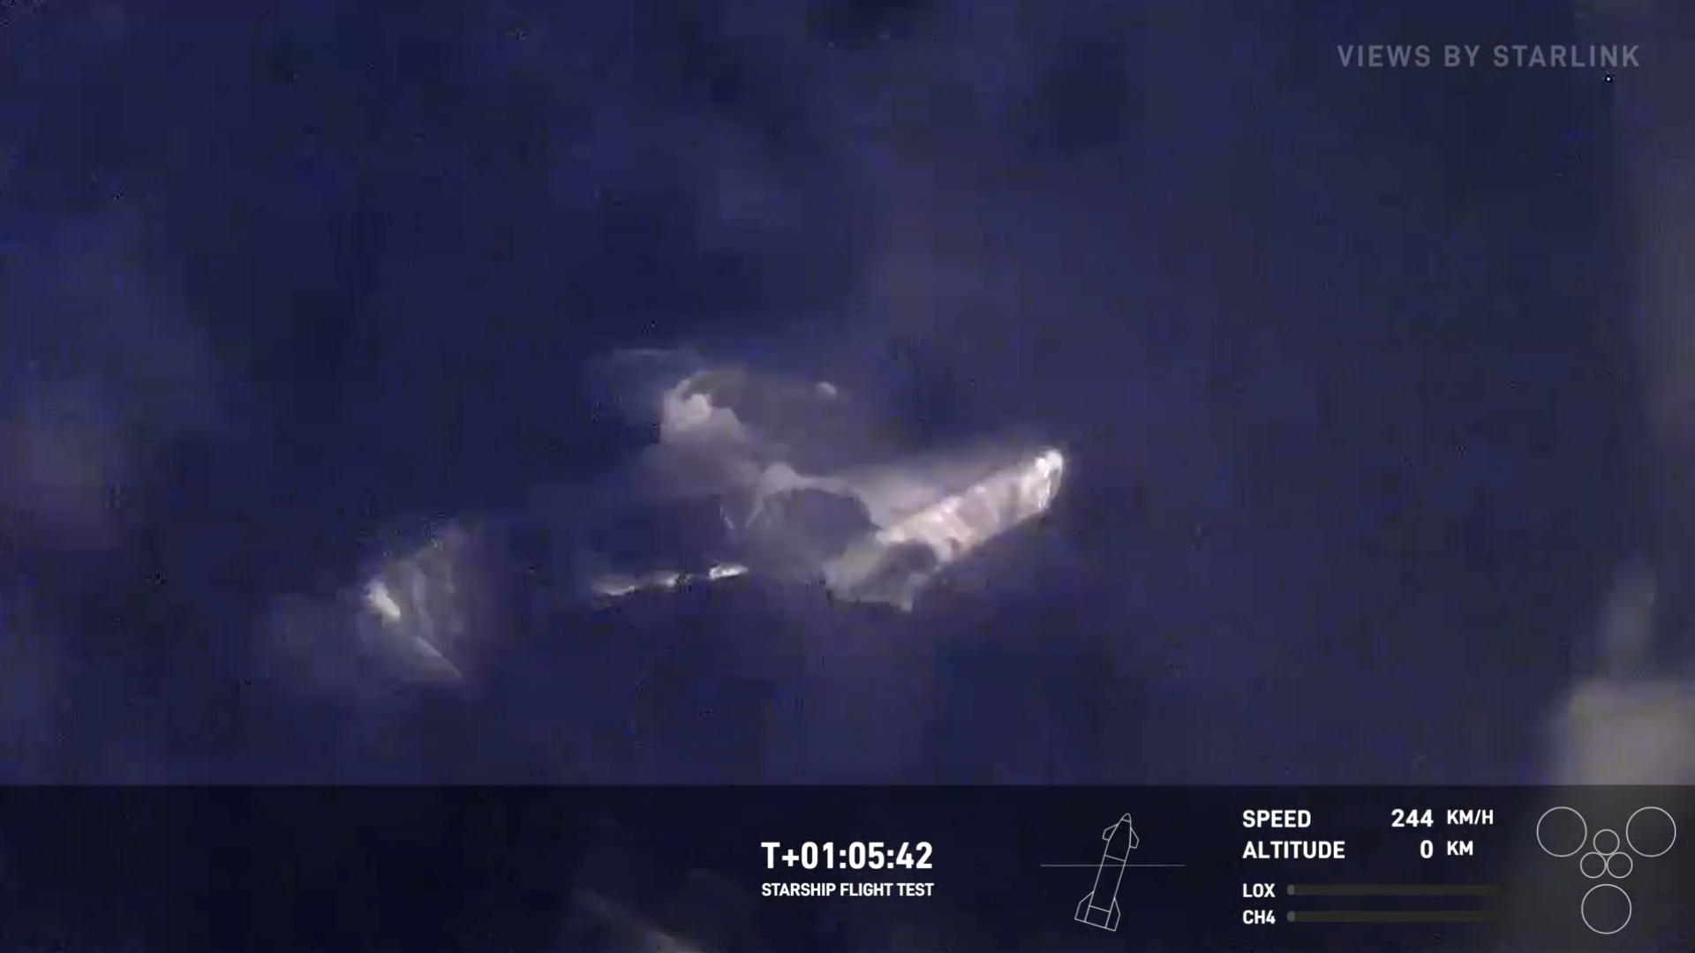

Slide 11
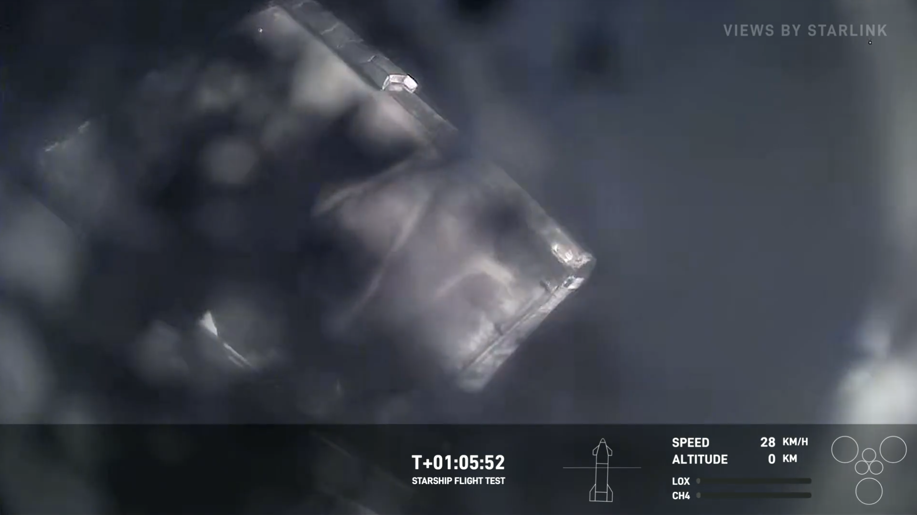

Slide 12
Governing Equations
Deriving quasi-parallel linear stability theory

Slide 13
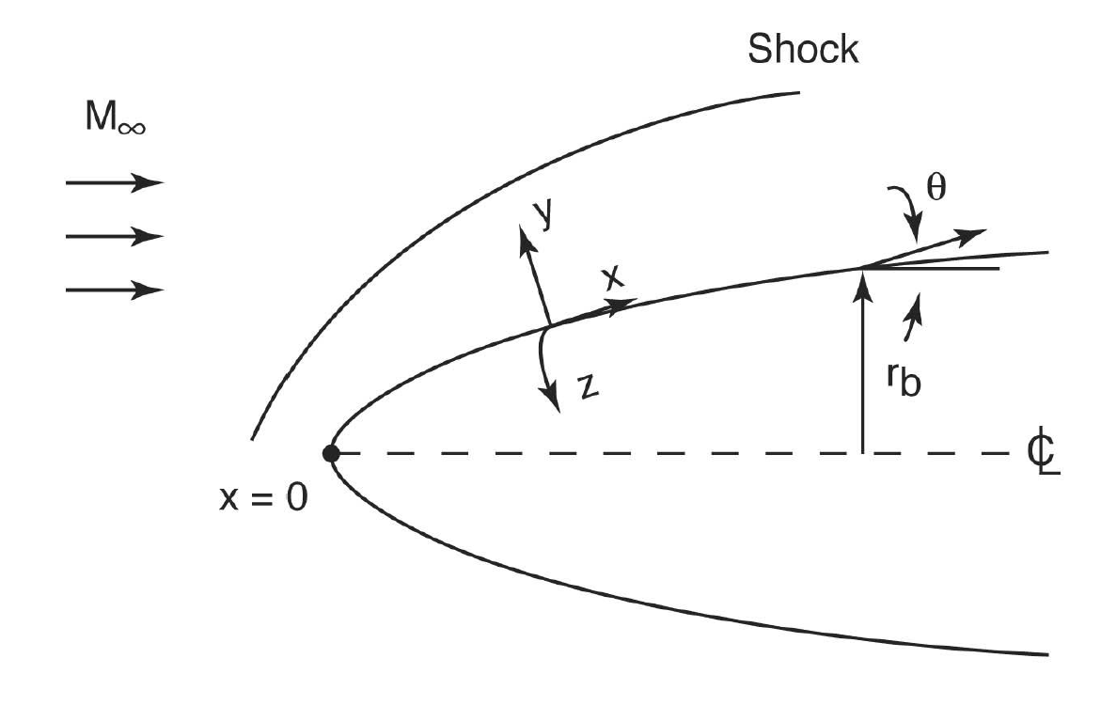
Governing Equations
Notes:
Compressible axisymmetric or 2D flow.
Coordinates defined as following:
X is streamwise
Y is wall-normal
Z is spanwise (or azimuthal direction for axisymmetric)
R_b is local radius but only defined for axisymmetric boundaries.

Slide 14
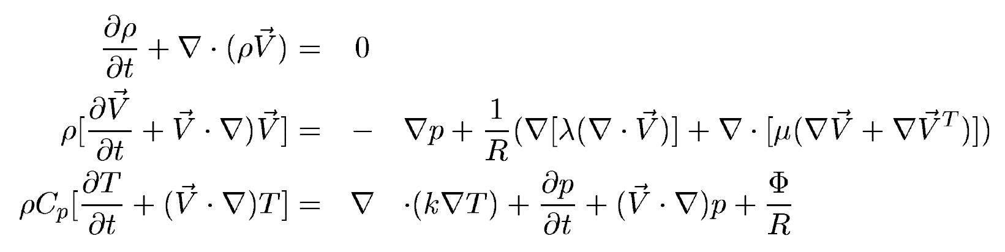
Governing Equations
Notes:
The evolution of disturbances is governed by the compressible Navier-Stokes equations (conservation of mass, conservation of of momentum, conservation of energy
V velocity
Rho density
P pressure
T temperature
Cp specific heat
K thermal conductivity
R Reynolds number
Mu is first coefficient of viscosity
Lambda second coefficient of viscosity

Slide 15
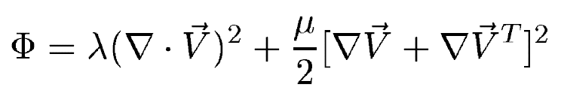
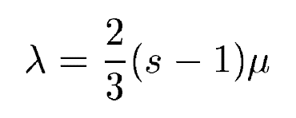
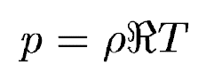
Governing Equations
Notes:
The viscous dissipation function is defined as Phi, which is the rate at which kinetic energy of a fluid is transformed into heat due to the viscous forces. (what are the units?)
The first coefficient of viscosity has units of pascal-seconds. It is known as the dynamic viscosity. It measures the fluid’s resistance to shear or tangential stress: shear stress = mu x du/dy. It measures how internal friction within the fluid resists layers sliding past each other
The second coefficient of viscosity also has units of pascal-seconds. It is known as the bulk viscosity. It accounts for the viscous resistance to volumetric or compressional deformation. It is significant in compressible flows and flows involving rapid volume changes, like shock waves.
The two coefficients of viscosity are related by the stokes parameter, which is a measure of the deviation from “Stoke’s hypothesis”, which says that lambda = -2/3 mu. So if s = 0, you get Stoke’s hypothesis (which is assumed in this case). For an ideal gas, one takes s=1, which means lambda = 0.

Slide 16
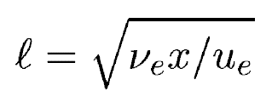
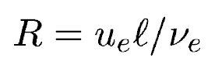
Governing Equations
Notes:
LASTRAC likes to dimensionalize with a reference length scale that uses the x coordinate of the point in the flow. We will have to deal with this later on because we want to keep our prediction tools coordinate-invariant, meaning that we want to make predictions based on a similarity solution of a boundary layer profile.
Nu_e is the kinematic viscosity coefficient, or mu_e / rho_e at the edge of the boundary layer. We define a length scale from that which we will use for our Reynolds number. We then use this to help non-dimensionalize the first equation:
Lengths are scaled by L
Velocities scaled by U_e
Density scaled by rho_e
Pressure scaled by rho_e * u_e^2
Temperature by T_e
Viscosity by mu_e
Time by L/U_e

Slide 17
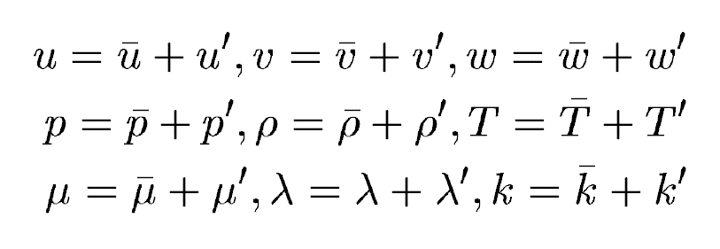
Governing Equations
Notes:
The solution to the Navier-Stokes equations consists of two parts:
The mean laminar flow solution, which represents the steady, time-averaged component of the flow.
The disturbance fluctuation, which represents the unsteady, time-varying component of the flow.
Total quantity = averaged quantity + fluctuation quantity

Slide 18
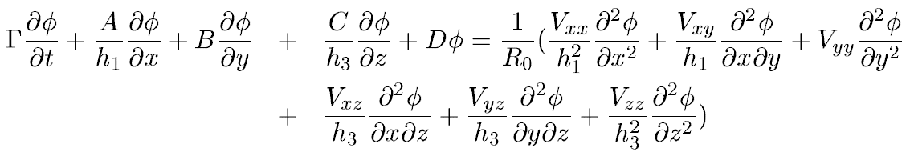
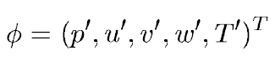
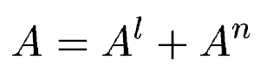
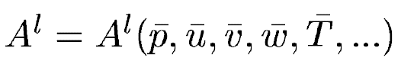
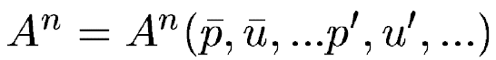
Governing Equations
Notes:
When we substitute the mean and disturbance quantities into the Navier Stokes equations, we get the following relation, where
Phi = “disturbance vector”
The coefficient matrices Gamma, A, B, C, D, Vxx, Vxy, etc are all the Jacobians of the flux vectors, R_0 is the Reynolds number used to normalize the equations, which is based on L_0 that is a length scale defined from the boundary layer as before.
Additionally, h_1 and h_3 are metrics of curvature in the spanwise and streamwise directions, but in our case, for a 2D flat-plate flow these quantities are 1.
These matrices can be divided into a mean flow and perturbation quantities, for example with A^l and A^n that are defined here. We will use this later to help linearize the equations.

Slide 19
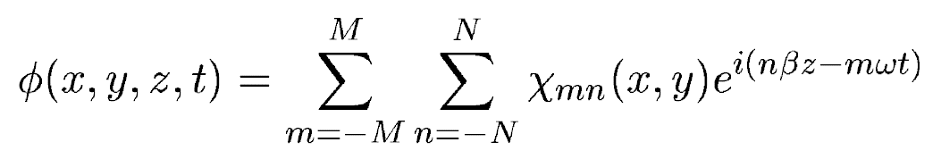
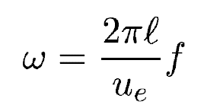
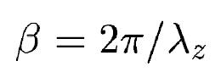
Governing Equations
Notes:
For a 2-D or infinite swept boundary layer, we assume the disturbance field is periodic in both temporal and spanwise directions. The disturbance vector phi can then be expressed as the following discrete Fourier series.
Omega is the nondimensional wave number related to the temporal frequency.
Beta is the nondimensional span-wise wave number, where lambda_z is spanwise wavelength normalized by the length scale
M and N are the number of Fourier modes included in the calculation in time and space.
The mode shape of a mode (m, n) is represented by the complex vector chi_{mn}

Slide 20
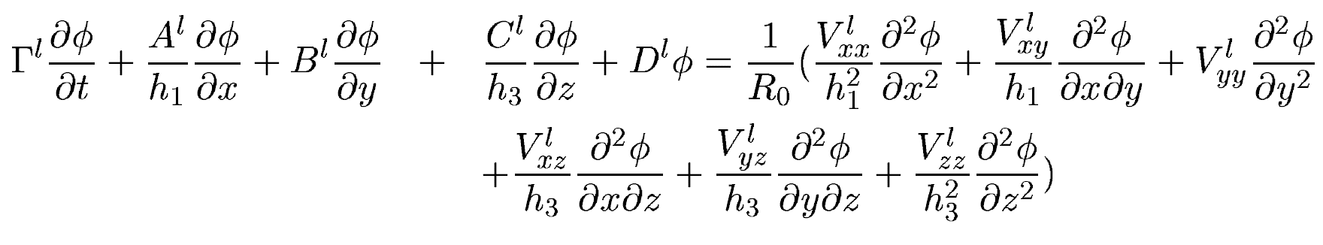
Linearizing Equations
Notes:
In order to reduce the computational complexity, we assume that the disturbance amplitude is very small relative to the mean quantities. This means that each Fourier mode evolves independently, and that nonlinear interaction among disturbance modes is negligible.
If we wanted, we could define phi for a single disturbance m=1 and n=1, substitute it into the linearized equation, discretize in both x- and y- directions, then solving for phi reduces to solving a linear system with a forcing determined by the boundary conditions. However, we want to take it a step further…

Slide 21
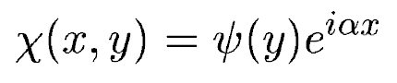
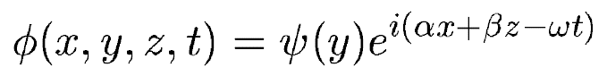
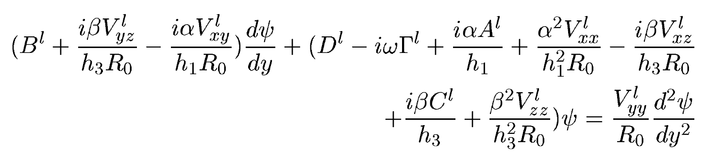
Quasi-Parallel Assumption
Notes:
In the linear stability theory, we assume that the mean flow evolves much more slowly in the streamwise direction than in the wall-normal direction. As a result, in the vicinity of a given location, the mean flow is quasi-parallel, i.e. the mean flow variation in x is negligible. The disturbance mode shape thus is assumed to have the following wave form, which describes a wave that propagates in the streamwise direction and has a different amplitude as a function of the wall-normal direction.
This turns the disturbance vector phi into the following. Here, alpha is the local streamwise wave number at the given streamwise location.
Then we put this into the linearized Navier-Stokes equations,
Neglect the mean wall-normal velocity component, and
Neglect all viscous terms that are of order 1/R^2 or lower,
We then get the bottom right relation. The viscous term in the wall-normal direction is retained in the above equation to handle viscous instability such as the Tollmien-Schlichting wave. Otherwise, this is a set of ODEs. Along with a set of homogenous boundary conditions, it boils down to an eigenvalue with the dispersion relation alpha = alpha(omega, beta), where alpha is a complex number with real and imaginary parts. The stability calculations in LASTRAC are formulated as a spatial stability problem, meaning that for a given disturbance frequency omega and spanwise wave number beta, the complex eigenvalue alpha is solved numerically. When the imaginary part is less than 0, the eigenmode is unstable. The corresponding solution of psi is the eigenfunction of the mode under consideration.

Slide 22
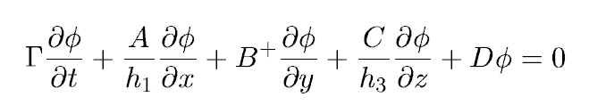
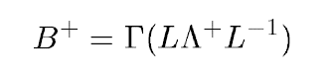
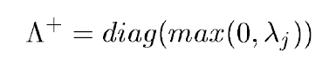
Boundary Conditions
No slip conditions: u, v, w, T = 0 at wall
Non-reflecting boundary conditions at the far field, derived based on inviscid Euler equations:
Notes:
Viscous effects are negligible in the fair field.
B plus is defined such that L lambda+ L-1 is the eigendecomposition of B+ times Gamma inverse, but modified such that it only has the positive eigenvalues of that matrix.

Slide 23
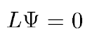
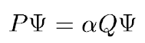
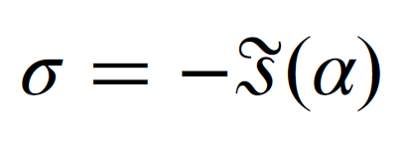
Numerical Solution
Discretize the ODE(s) with finite-difference of varying orders. The result is solving and eigenvalue problem.
This is solvable with the inverse Rayleigh iteration method.
The growth rate of the instability wave is the imaginary part of the eigenvalue. These growth rates can be used to predict transition.
Notes:
L is a function of linear Jacobian matrices from before and wave numbers, omega alpha beta. L is linear in omega and contains terms of alpha^2 due to the viscous terms. However, if we neglect the viscous terms in , we can recast it to the following.
Solve this with a LOCAL EIGENVALUE SEARCH, where we start with an initial guess of alpha as an eigenvalue.

Slide 24
First and Second Mode Instability
First mode instability: (TS Waves)
Occur typically due to the interaction of the mean flow with viscous effects, leading amplification of small disturbances
Typically lower frequency, dominate at lower Mach numbers, and have a smaller growth rate than second mode instabilities.
Second mode instability: (Mack Modes)
Occur due to acoustic disturbances within the boundary layer and amplified due to compressibility effects.
Higher frequency, higher Mach numbers, and have larger growth rates.

Slide 25
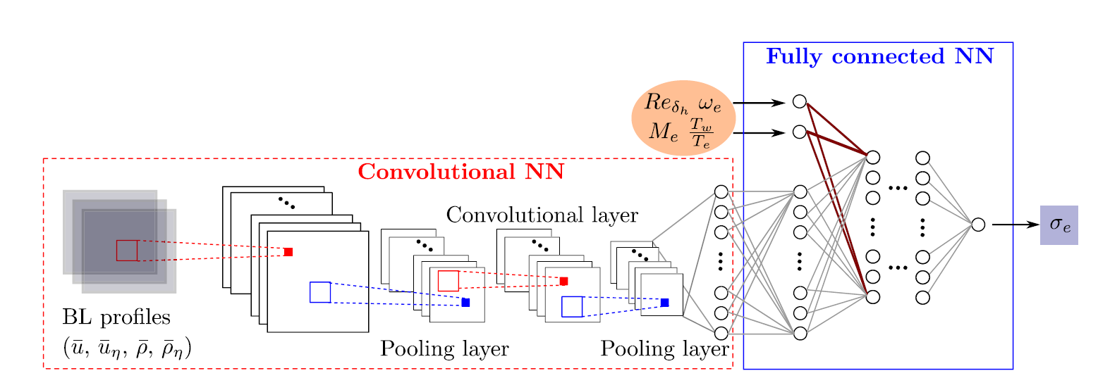
Machine Learning Model
Introduced by Paredes et al., we used a model that predicts growth rates using boundary layer profiles and non-dimensional parameters that are unique to the flow field.
Notes:
Here we use a CONV NN which takes in the boundary layer profiles in the form of velocities and densities. They undergo multiple layers of convolution and pooling. What this does is allow the model to expand out the information it gathers from the BL profiles into many more dimensions with a convolutional layer. Then it forces the model to choose which parts of the data from each of these dimensions is the most important to the model. We repeat this three times, then pass the resultant “latent” vector of 8 values along with Re, Me, omega_e, and Tw/Te into a fully connected NN that finally predicts the growth rate at this particular instance.
All values are nondimensional and normalized in order to preserve invariance of the model to the position within the flow, or the specific airfoil type.
Where a length scale is needed, the boundary layer thickness is used, which further ensures the locality of the solutions.

Slide 26

Convolutional Neural Networks
Allows for the expansion of dimensions and identification of important features from multi-dimensional input.

Slide 27
Adjustments Made to Paredes Model
Neglected the usage of the wall-normal derivatives of boundary layer
Mean and variance scaling (commonly done in regression)
Used LeakyReLU activation functions which allow for some negative values in the neurons and reduces the possibility for dead neurons
Attempted “benign overfitting”– allowing for a larger parameter space than number of datapoints.

Slide 28
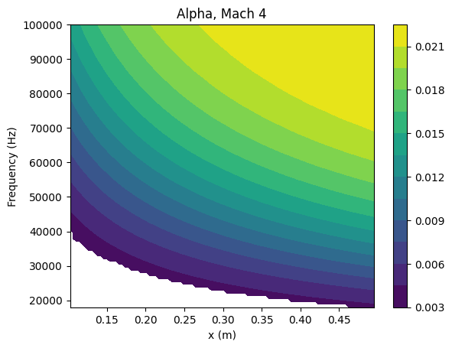
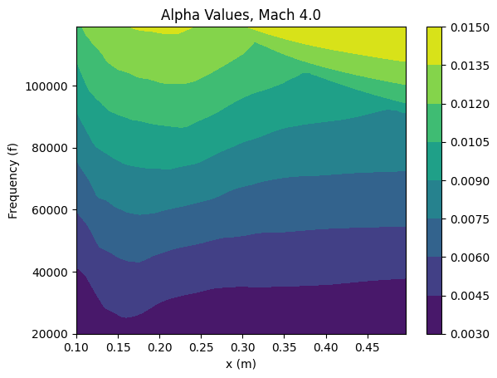
First Mode Results – Mach 4

Slide 29
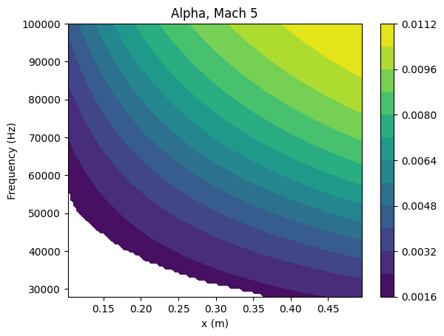
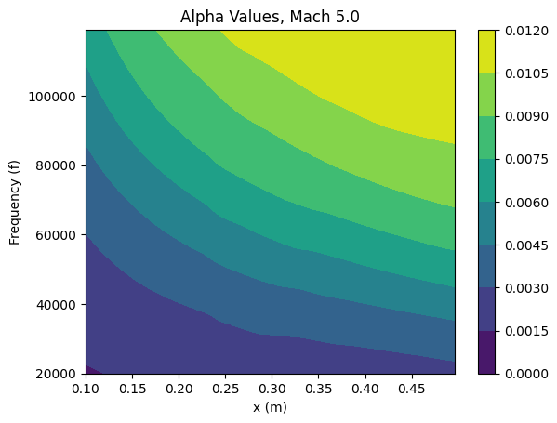
First Mode Results – Mach 5

Slide 30
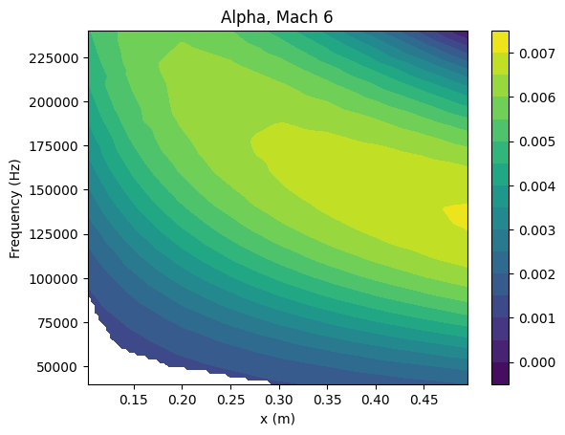
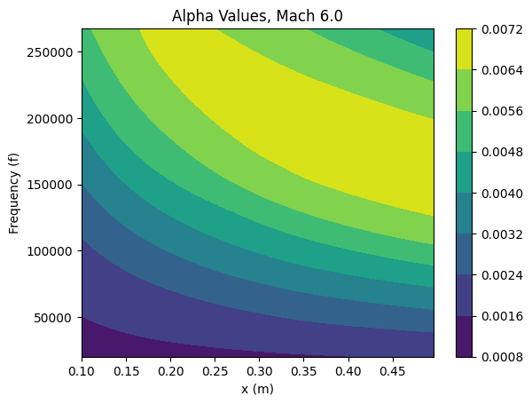
First Mode Results – Mach 6

Slide 31
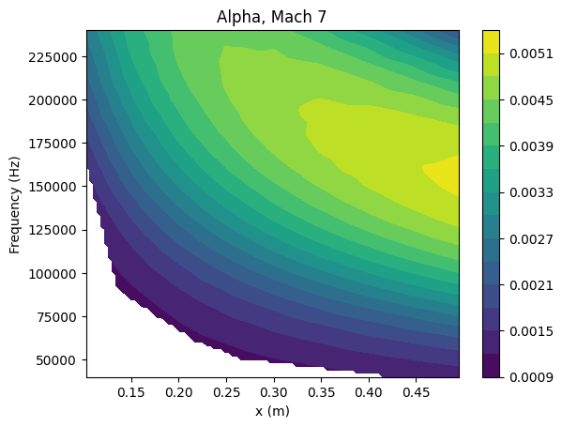
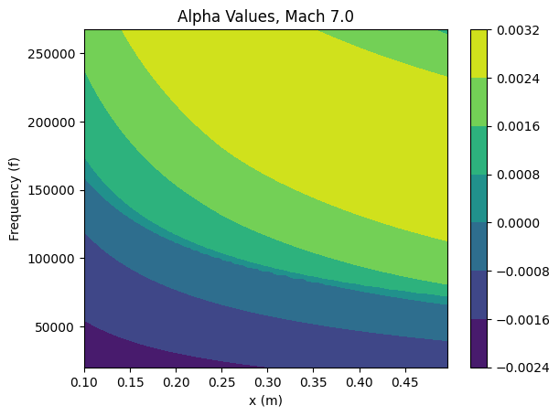
First Mode Results – Mach 7

Slide 32
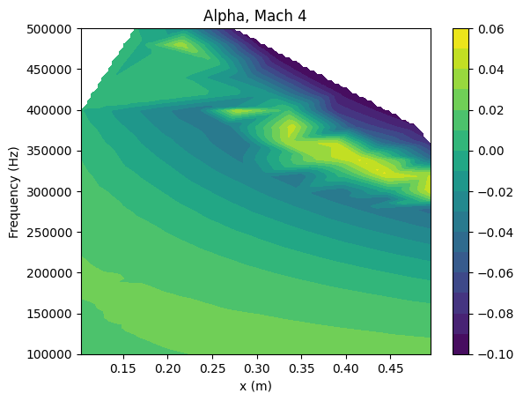
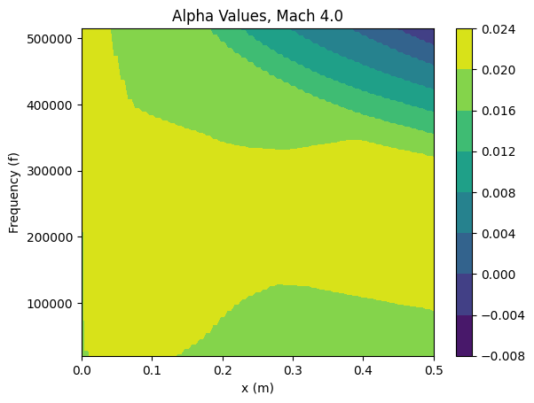
Second Mode Results – Mach 4

Slide 33
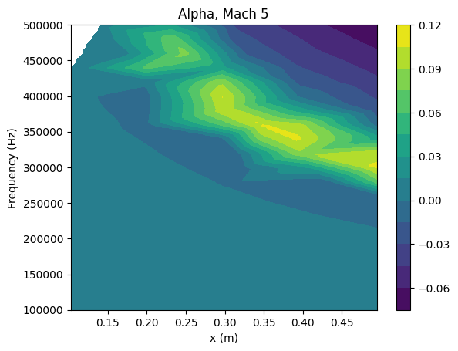
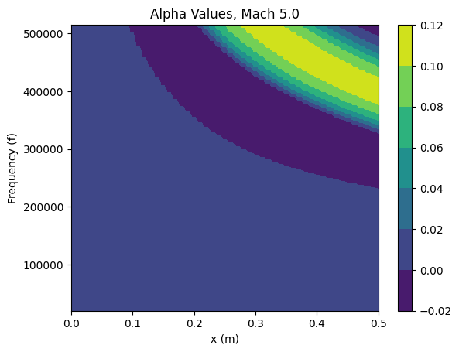
Second Mode Results – Mach 5

Slide 34
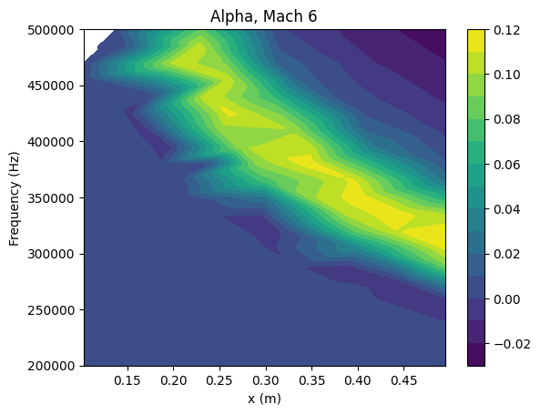
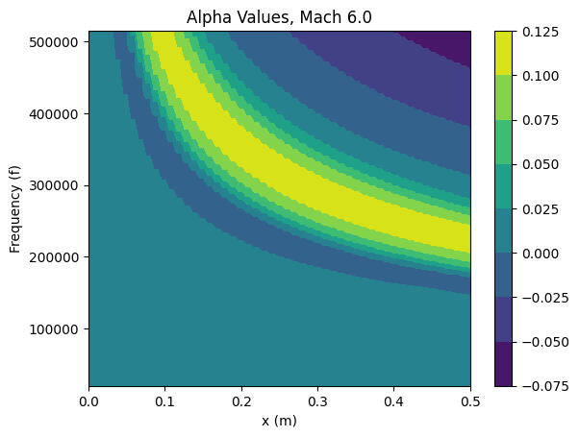
Second Mode Results – Mach 6

Slide 35
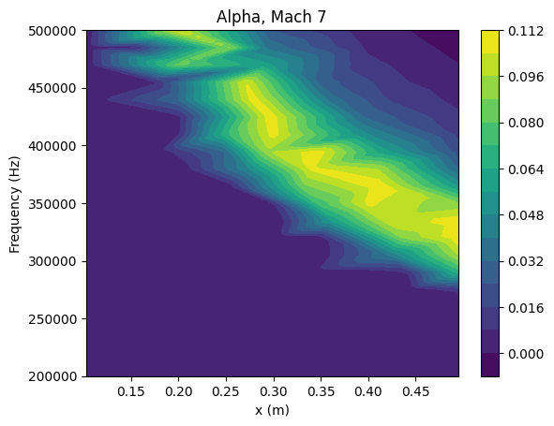

Second Mode Results – Mach 7

Slide 36


Predictions – First and Second Mode, M 5.75

Slide 37
Conclusion
Machine learning models have powerful prediction capabilities that can be used to inform the prediction of laminar-to-turbulent transition in hypersonic boundary layers
These pre-trained models can be extended for predicting transition for different airfoil shapes, since the inputs and outputs are non-dimensionalized or otherwise not related to global flow quantities.
Notes:
Global flow quantities like the position within the flow.

